Slide 1
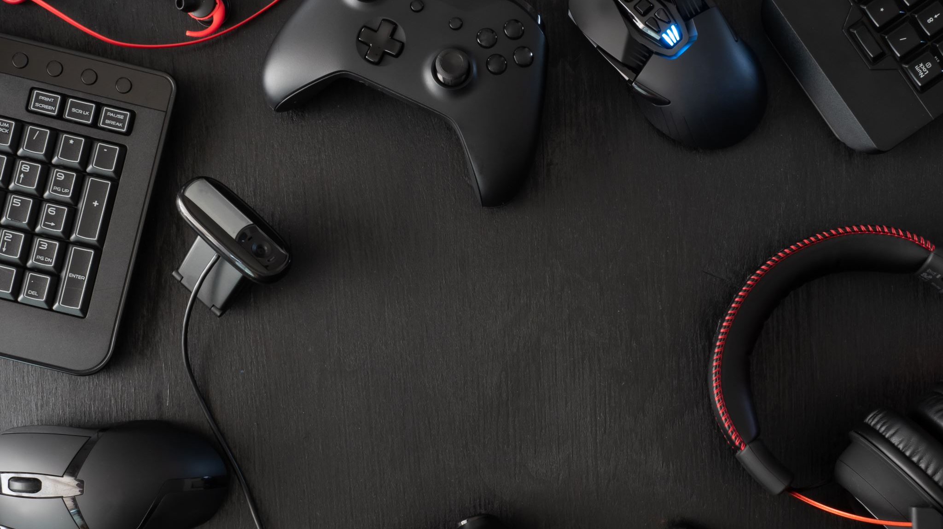

Video Games UX Research
Miguel Castillo
Notes:
In the last couple of presentations, I’ve explored methods and mindsets for understanding user problems and uncovering opportunities to design solutions that help them complete their tasks. Whether it’s through contextual design, participatory design, or by understanding how to design for neurodivergent users, the focus has been on addressing challenges by creating solutions that are usable, efficient, and accessible.
But what happens when the goal isn’t to increase efficiency, but to create fun experiences? When success isn’t about ease of use, but about engagement, emotional impact, and enjoyment?
That’s what differentiate games user research. While many of the same research methods still apply, the purpose and what researchers optimize for is different. Today, I’ll be diving into what it means to research for games and how researchers help make better games.

Slide 2

What’s UX Research?
UX Research
A systematic process of gathering and analyzing information about the target audience or users of a product, service or system to understand their behaviors, needs, and motivations in order to inform design decisions.
Goals
Efficiency
Ease of use
Goal completion
Exploratory and evaluative research
Exploratory = understand problem
Evaluative = evaluate approach
Qualitative and quantitative methods
Qualitative = why
Quantitative = what
Attitudinal and/or Behavioral
Attitudinal = listen to what users say
Behavioral = observe what users do
Notes:
In the last presentations we’ve heard about User Centered Design.
UCD
An iterative design process in which designers focus on the users and their needs in each phase of the design process. In UCD, design teams involve users throughout the design process via a variety of research and design techniques, to create highly usable and accessible products for them.
To create user-centered solutions, designers need to understand their users and validate their designs—and the way to do that is through research. User research is a systematic process of gathering and analyzing information about the people who will use a product, service, or system. It helps researchers understand their behaviors, needs, and motivations in order to inform design decisions and ultimately improve the user experience.
contextual design or participatory design
In mainstream UX, the focus is typically on goals like:
Efficiency
Ease of use
Task or goal completion
Example: Think about ordering an Uber. The user’s goal is clear: find a ride at the best price, as quickly and easily as possible. The experience should be seamless, efficient, and intuitive—focused on reducing friction.
User research can be applied at any stage of the design process. Each stage brings different questions, which influence the type of research needed. Early on, research is often exploratory—focused on understanding the problem space. Later, it becomes more evaluative—testing how well a design works with users.
Researchers often start with qualitative methods to explore user needs, behaviors, and motivations. These insights may then be validated through quantitative methods to identify patterns or measure impact at scale.
Research approaches typically fall into two categories:
Attitudinal – Listening to what users say
Behavioral – Observing what users do
Now, this still applies in video games—usability matters—but the product goals are different.

Slide 3
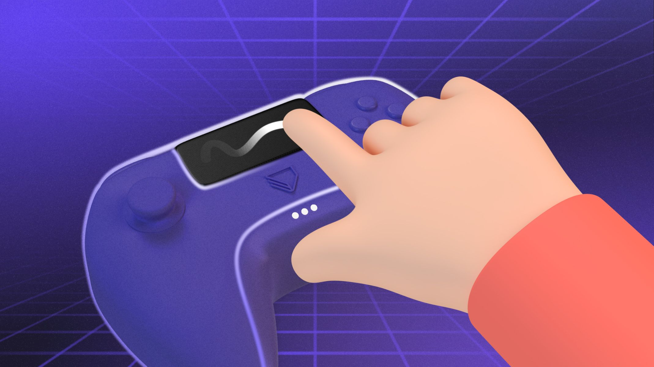
What’s Video Games UX Research?
Games UX Research
Focuses on understanding players’ behavior, interactions, and experiences in videos games. Researchers use methodologies like observations, interviews, and surveys to gather valuable data. This data helps improve games, remove bugs, and increases player experience.
Goals
Fun
Enjoyment
Immersion
Designers vision = Users expectations?
Notes:
When playing a video game, the goal is not usually to complete it as quickly or easily as possible, but to enjoy the challenge, explore the world, or get immersed in the story—and that often includes intentional friction.
Games are a form of entertainment, like movies. Game designers create video games with the intention of creating an emotional response. Therefore, in games, user researchers approach their work from the designer’s point of view. Unlike other products where designers rely on user research to decide what to create, game designers begin with a vision, and researchers evaluate if users' experience matches the designers’ vision.
Games User Research
Focuses on understanding players’ behavior, interactions, and experiences in videos games. Researchers use methodologies like observations, interviews, and surveys to gather valuable data. This data helps improve games, remove bugs, and increases player experience.
Goals
Fun
Enjoyment
Immersion
User research help uncover potential issues in the game mechanics, user interface, or any other aspect that could negatively affect the player's experience.
For example, if the purpose of a horror game is to make players feel scared and nervous, the research team’s goal is to find out how the players are feeling. If the players are not “scared enough,” the designer can use research insights to reach their vision.

Slide 4
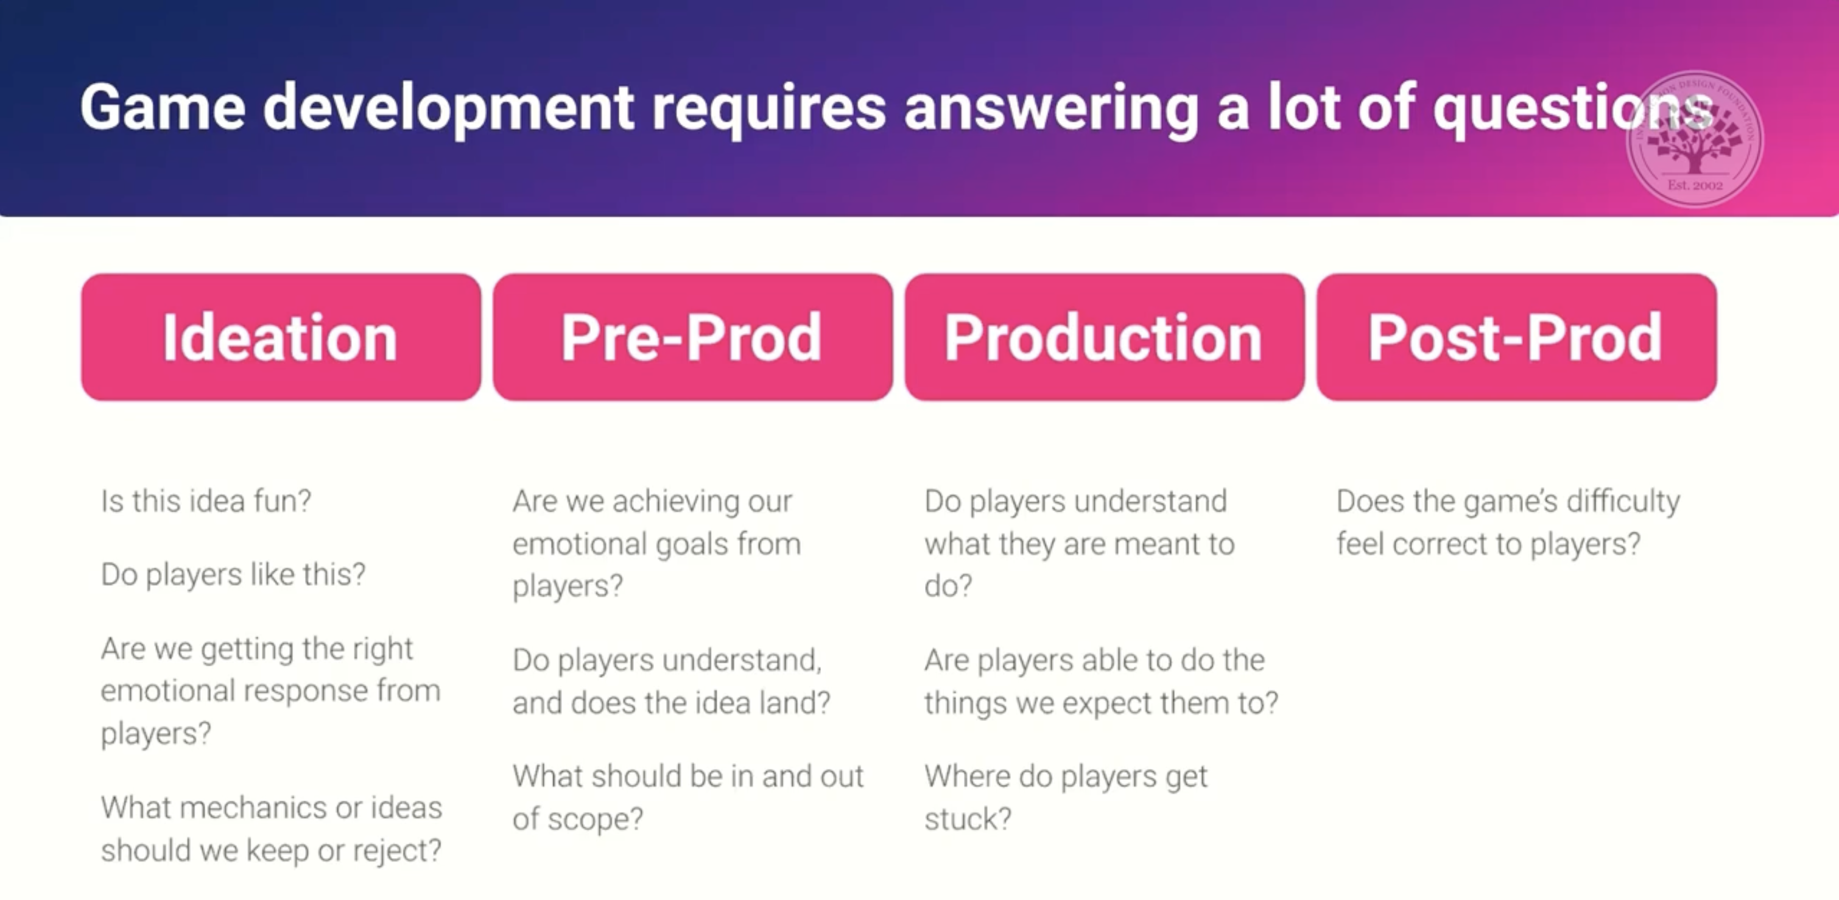
What’s Video Games UX Research?
Notes:
User research can be applied at any stage of the design process. Each stage brings different questions, which influence the type of research needed. Early on, research is often exploratory—focused on understanding the problem space. Later, it becomes more evaluative—testing how well a design works with users.

Slide 5
What’s Video Games UX Research?
Games are designed to be fun and that often comes from friction
Intentional friction vs Unintentional friction
Playtesting
Playtesting is where users play the game, and researchers collect data using qualitative and quantitative approaches.
Biometrics / Physiology
Using tools like eye tracking, heart rate, or skin response to measure real-time emotional reactions.
Telemetry (Game Analytics)
Analyzing large-scale behavioral data — e.g., where players fail, quit, or succeed.
Ex. Kill/Death Ration
Notes:
Unlike other products, games are designed to be fun — and that often comes from friction.
In games, difficulty enhances the experience, keeping players engaged and helping them build skills. The explicit goal might be “defeat the boss,” but the real goal is to have fun overcoming challenges.
Designed on purpose to create challenge, tension, or emotional impact.
Examples:
Limited stamina in Zelda: Breath of the Wild to encourage strategy
Slow reload times in survival horror games to increase tension
Complex puzzles that challenge problem-solving skills
Restricted fast travel to encourage exploration
Not designed deliberately—usually a byproduct of poor design, oversight, or technical limitations.
- Confusing UI that makes it hard to find inventory
- Bugs or glitches that interrupt gameplay
- Poorly explained mechanics that leave players lost
- Menus that are hard to navigate with a controller
While the research process is similar to traditional UX — using methods like interviews, observations, and surveys — the questions and goals differ. Games user research (GUR) often involves specialized methods, such as:
Playtesting: Watching players interact with a game build; used throughout development.
Biometrics / Psychophysiology: Using tools like eye tracking, heart rate, or skin response to measure real-time emotional reactions.
Telemetry (Game Analytics): Analyzing large-scale behavioral data — e.g., where players fail, quit, or succeed.
An example is the kill/death ratio: if designers made the game interface too good at killing bosses, that would be efficient, but not fun. Gamers need just the right level of challenge.

Slide 6

Playtesting
Playtesting
Playtesting is where users play the game, and researchers collect data using qualitative and quantitative approaches.
Playtesting pitfalls
Playtesting with the wrong people
Running studies late in the development process
Using inappropriate methods
Biased questions design and analysis
Playtesting is not the same as QA
QA = QA testers look for bugs, glitches, crashes
Notes:
Let’s come back to playtesting.
While playtesting is a common practice among game developers and designers — often just putting people in front of the game — it’s important to note that developers are not always trained researchers. As a result, their playtests can run into several pitfalls, such as:
Testing with the wrong participants (e.g., themselves, coworkers, or overly familiar players)
Conducting playtests too late in development
Using inappropriate or inconsistent research methods
Designing biased questions or misinterpreting data
Focusing only on bug finding, rather than the overall player experience
In addition, playtesting is often confused with Quality Assurance; however, they are different. Playtesting focuses on the player experience — how fun, engaging, and intuitive the game is — while QA (Quality Assurance) is concerned with the technical performance of the game. QA testers look for bugs, glitches, crashes, and other issues that could break gameplay. Their goal is to ensure the game runs smoothly, follows requirements, and is free of defects before release.

Slide 7
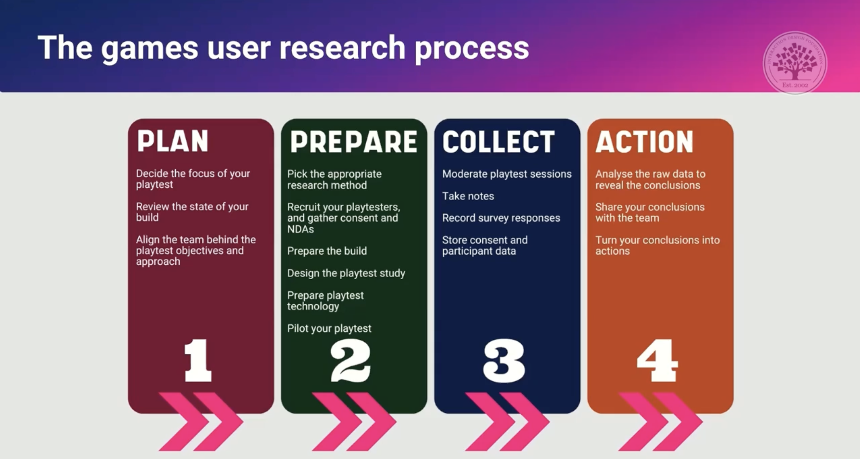
What does the process look like?
Notes:
The research process is very similar to that of mainstream ux.

Slide 8
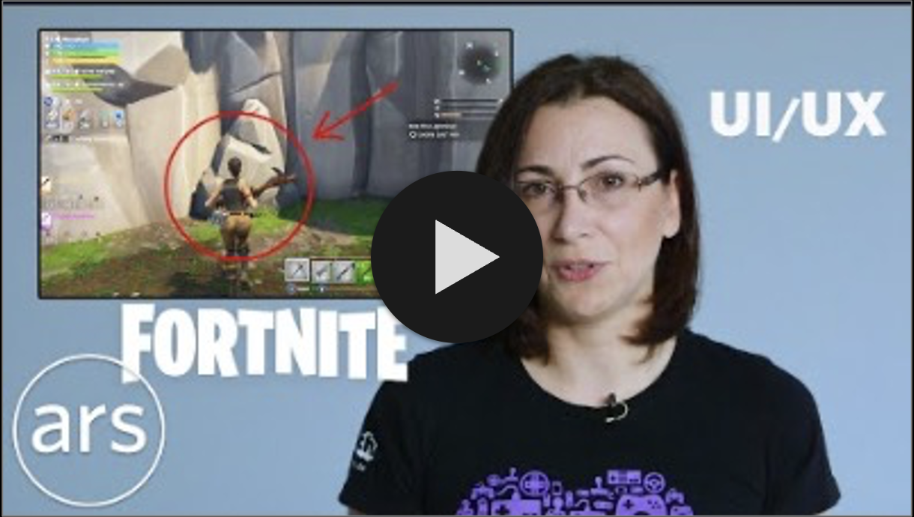
Example of Good UX in Video Games
Notes:
This video is a great example of how thoughtful design that aligns with how players expect to interact with a game can enhance the overall experience—even if it’s not explicitly about user research, it shows how good UX can significantly increase enjoyment and immersion. Again, this comes from running research through the game development process.

Slide 9
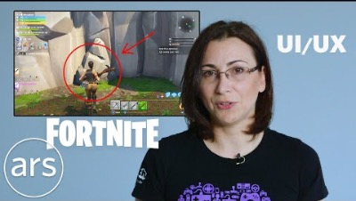
Example of Good UX in Video Games

Slide 10

Challenges
Time
Budget
Secrecy
Notes:
As you can see, involving the right users in the development process can be very impactful. When only game studio employees play the game during development, their familiarity with the design introduces bias—they’re more likely to overlook issues because they already understand how everything works. While this approach may seem efficient, saving time and money in the short term and helping the game launch sooner, it can backfire. Once released, real players might struggle with the story, game mechanics, or UI. They may find the game boring, confusing, or too difficult to understand. As a result, the game may receive poor reviews, sell fewer copies, and ultimately be considered a failure by the industry.
Just like in mainstream UX, time constraints and budget limitations can present major challenges for Games User Research. Without enough time or resources, teams may struggle to recruit the right participants or conduct meaningful testing. As a result, research can be rushed—or skipped altogether
In addition to these challenges, secrecy plays a much larger role in games than in many other industries. While mainstream UX often involves confidentiality around specific features, in games, the entire product is typically kept under wraps until launch.
Marketing and advertising are critical to a game’s commercial success, so studios go to great lengths to prevent leaks that could undermine planned campaigns. Because of this, Games User Research often uses different approaches than traditional UX. Researchers might rely on internal playtests, trusted user panels under NDA, or lab-based studies with strict confidentiality controls. While the methods may vary, the goal remains the same: ensuring the game delivers the intended experience for players.

Slide 11

Thank you!
Thank you very much for your time! If you have any questions, please contact me via - cast4317@vandals.uidaho.edu

Slide 12
References
Interaction Design Foundation - IxDF. (2023, December 14). What is Games User Research?. Interaction Design Foundation - IxDF. https://www.interaction-design.org/literature/topics/games-user-research
Nielsen, J. (2019, November 12). Games user research: What’s different? Nielsen Norman Group. https://www.nngroup.com/articles/game-user-research/
Fortnite UX Designer Breaks Down Fortnite’s UI / UX | Ars Technica. YouTube. (2018, September 13). https://youtu.be/4DE_4HUX94E

